Slide 1
Simulations
EQ – How do I run a simulation and communicate my findings using the statistical thinking process?
There are a few of you that need to remember:
PEOPLE MATTER
100% RULE
STATISTICAL Investigation 2- Simulations will be held tomorrow (last lesson ) and Monday. Two lessons in class only. INB can be used.

Slide 2
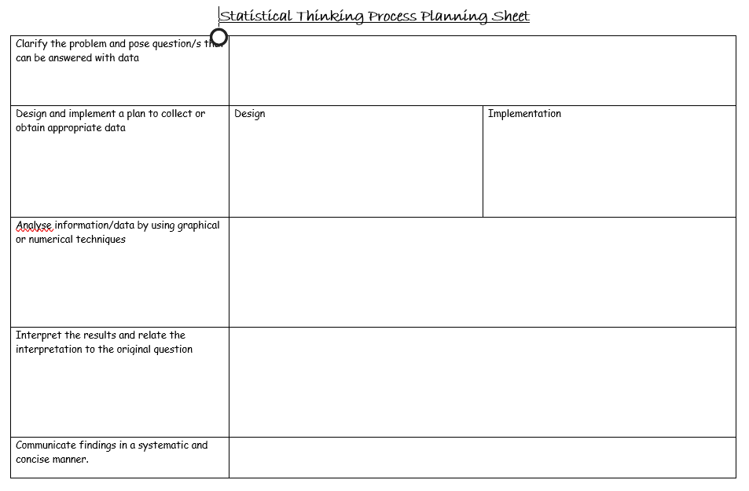
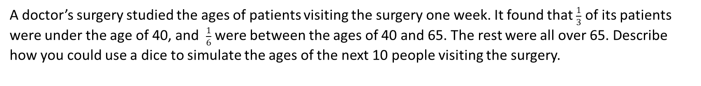
24
7
30
Simulations
Date
EQ – How do I run a simulation and communicate my findings?
A doctor’s surgery studied the ages of patients visiting the surgery one week. It found that $\frac{1}{3}$ of its patients were under the age of 40, and $\frac{1}{6}$ were between the ages of 40 and 65. The rest were all over 65. Describe how you could use a dice to simulate the ages of the next 10 people visiting the surgery.

Slide 3
24
7
30
Simulations
Date
EQ – How do I run a simulation and communicate my findings?
A local authority is collecting data about traffic leaving town on a main road. It is going to carry out some long-term road works and plans to put up traffic lights for safety. It found that in any period of 10 seconds it is possible that 0, 1, 2 or 3 cars may pass the place where workers are going to dig. The results of a survey from data collection is shown in the table.
a) The local authority sets the traffic lights to red for 90 seconds. Set up and run a simulation to find how many cars are likely to be in the queue at the end of the 90 seconds.
b) Run your simulation 5 times. From your data, what is the mean number of cars that are likely to be in the queue at the end of the 90 seconds.
Number of cars | 0 | 1 | 2 | 3
Frequency | 2 | 4 | 3 | 1
Notes:
Show students how to use calculator- alpha- . – 0- shift- ) 3 need to press = 9 times (because 90 sec) record in data table. Then do this again 5 times

